Slide 1

Get Started with Git
MH.Movasaghinia

Slide 2
VCS “Version Control System”
What you change
Time of change
Person who change
…
The best way to keep your files, projects,…

Slide 3
VCS “Version Control System”
Local Version Control
Centralized Version Control
Distributed Version Control

Slide 4

VCS “Version Control System”
Local Version Control
Local storage

Slide 5

VCS “Version Control System”
Centralized Version Control
Keep data on the Personal Server
Cannot keep data on your local devices

Slide 6

VCS “Version Control System”
Distributed Version Control
Just Changes
Keep data on Server and local Devices

Slide 7
Git Get started
At the first there is a Bitkeeper that just for Linux
Linus Torvalds created the Git look like the Bitkeeper

Slide 8
Git Advantages
Fast
Add just the changes
Undo ability everywhere
…

Slide 9
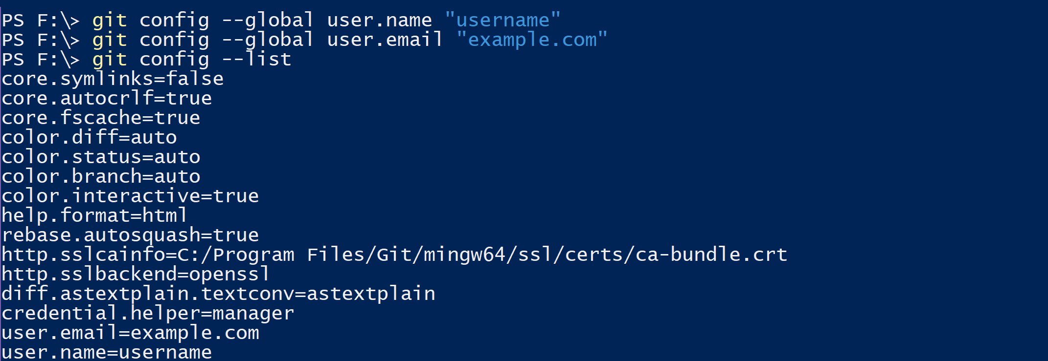
Git Commands
git config

Slide 10
Git Commands
$ git init
$ git status
$ git add “Filename.sample”
$ git commit “”
$ git remote add origin “https:\\...”
$ git push
$ git pull

Slide 11

Git Kraken

Slide 12
.gitignore file
https://www.gitignore.io/

